Slide 1
Welcome to Infrastructure as Code using Terraform
To get started, open the following link and read Chapter 0:
http://bit.ly/cpltf

Slide 2

Infrastructure as Code using Terraform
Presented by
Eric Rhoads &
Mike Branstein

Slide 3

Sponsors
Notes:
Before we dive in, we just want to take a moment to thank our sponsors for making this event possible.

Slide 4
Table of Contents
What is Infrastructure as Code?
Why use Infrastructure as Code?
What is Terraform?
How do I use Terraform?
DEMO
Q&A

Slide 5
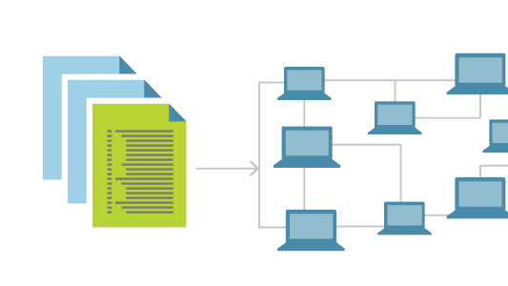
What is Infrastructure as Code?
Notes:
When we say infrastructure components, we mean things like the network, load balancers, and virtual machines. In the world of a public cloud like Azure, this can be expanded to include PaaS solutions, databases, and basically anything that isn’t the application code you write.
Infrastructure as code is the management of infrastructure components whether they are on premises or in the cloud, using a declarative model to define and control their configuration. These declarative configuration files are generally stored in source control systems and deployed using pipelines in the same way as application code.

Slide 6
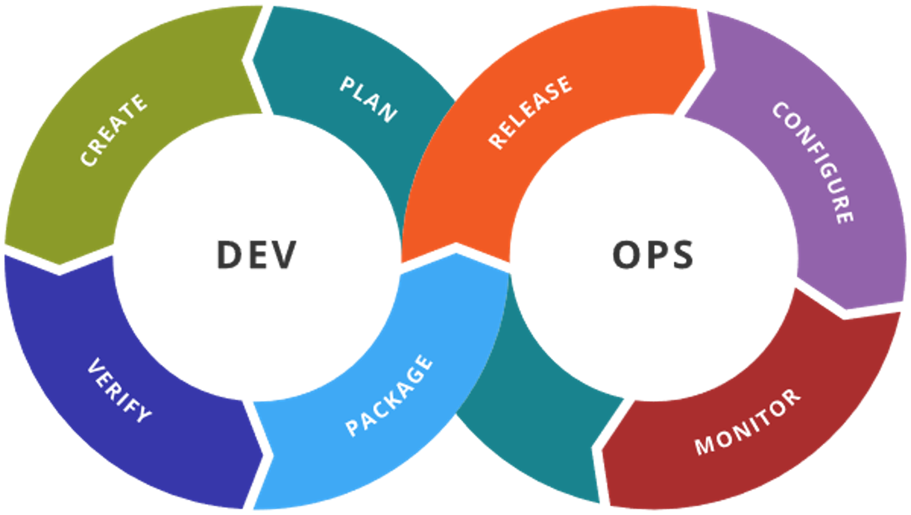
Why Use Infrastructure as Code?
Reusable
Accelerated
Consistent
Extensible
Notes:
Your team is developing a new application feature, and the infrastructure must be adapted. The first step is to change a file in source control that describes the infrastructure. When the file is saved it triggers a new build and release. The infrastructure is deployed to test and the whole process to get new infrastructure took minutes. And ... you didn't touch the infrastructure at all.
The model is inherently more secure, especially from an audit perspective where we can show – this is exactly how the environment is configured, who touched it, and who has access to it. It reduces human error, allows us to spin up the same environment multiple times to reduce environment drift, gets us new features, faster.

Slide 7

What is Terraform?
Free, broadly supported
Built on the GO Language
Simple declarative interface for various APIs
Providers are plugins
Notes:
Terraform is an open source infrastructure as code tool that codifies APIs into declarative configuration files. These files can be shared amongst team members, edited, reviewed, and versioned.

Slide 8

How Do I Use Terraform?
Providers declare what API we are using
Resources are the base class used to define and configure infrastructure components
Terraform Plan and Apply are commands used to commit the changes
State Files are the way in which we ensure consistency, especially when introducing changes
Notes:
We will be covering all of this in the workshop.

Slide 9
Let’s Workshop!
http://bit.ly/cpltf

